Slide 1
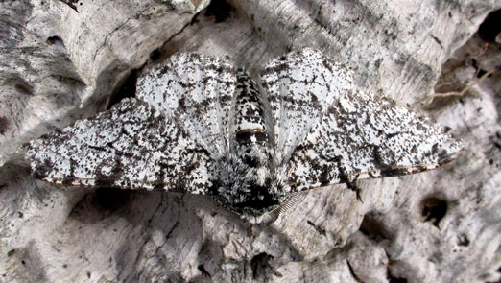
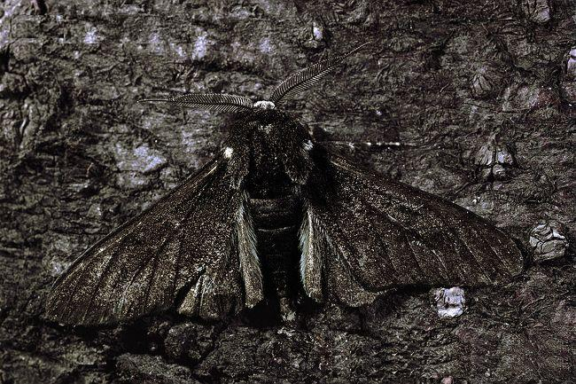
Part I Variation and Adapatation Part II Natural Selection

Slide 2
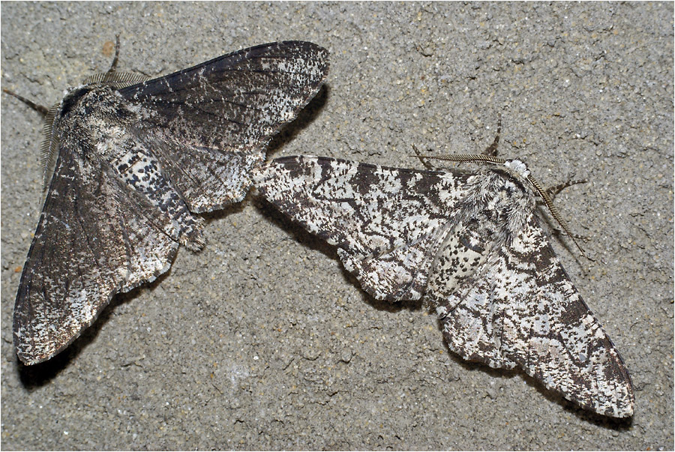
Are individuals in a population of a species the same?
No – all members of a species share the common characteristics of that species, but there are still differences
Variation – differences between individuals of the same species
EX. All dogs have hair, but not all dogs have the same color hair

Slide 3
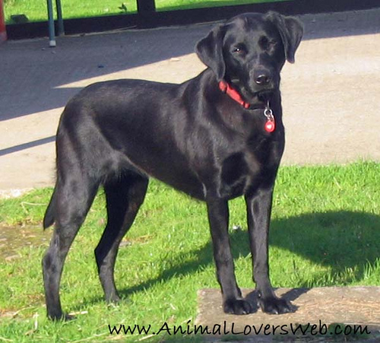
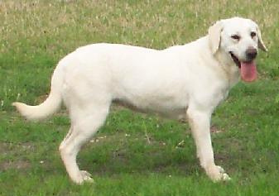
Dog Variation

Slide 4
What causes variation? There are 2 main causes of variations in a population:
Mutation – A change in the DNA of an organism that leads to a change in a protein being made by the organism
Sometimes the new protein can lead to a new trait
Mutations can be caused by DNA being copied incorrectly during replication, by mistakes during meiosis, or by radiation or chemicals in the environment

Slide 5
What causes variation? There are 2 main causes of variations in a population:
Recombination – The creation of a new set of DNA in offspring during sexual reproduction
Since each parent passes down only ½ of their DNA, the DNA in the offspring is a unique combination of DNA from both parents

Slide 6
How does variation lead to evolution?
Sometimes mutations or recombination results in a trait that improves an organism’s chances for survival (increases fitness)
Adaptation – a trait that helps an organism to survive and/or reproduce
There are 2 types of adaptations:
Structural Adaptation
Behavioral Adaptation

Slide 7
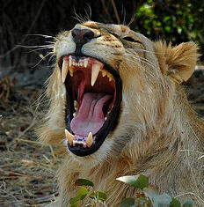
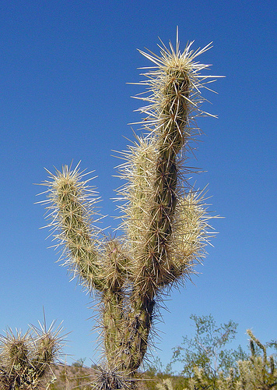
How does variation lead to evolution?
Structural Adaptation – a physical trait that helps an organism to survive (EX. the sharp teeth of a lion, the spines of a cactus)

Slide 8
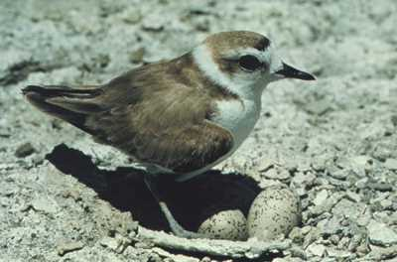
How does variation lead to evolution?
Behavioral Adaptation – a behavioral trait that helps an organism to survive (EX. plover birds faking injury to lure predators away from nest)

Slide 9
How does variation lead to evolution?
Adaptations are traits which means they are caused by genes
Organisms with the best adaptations have the “best” genes and highest fitness
These organisms survive and reproduce more, passing on their genes, and changing the relative frequency of genes in the gene pool of the next generation (“good” genes appear more frequently)

Slide 10
How does variation lead to evolution?
As the gene pool changes generation after generation, the species characteristics change or evolve
As time goes by, the species can undergo changes both minor and major (descent with modification), or even become a new species (speciation)

Slide 11
Darwin’s Observations
Patterns of Diversity
Organisms are extremely well suited to their particular environments
Similar ecosystems in different parts of the world have different organisms (EX. No rabbits in Australia)
Living Organisms & Fossils
Some fossils similar to living organisms, some different – How are they related to living species?
Why had so many species disappeared?

Slide 12
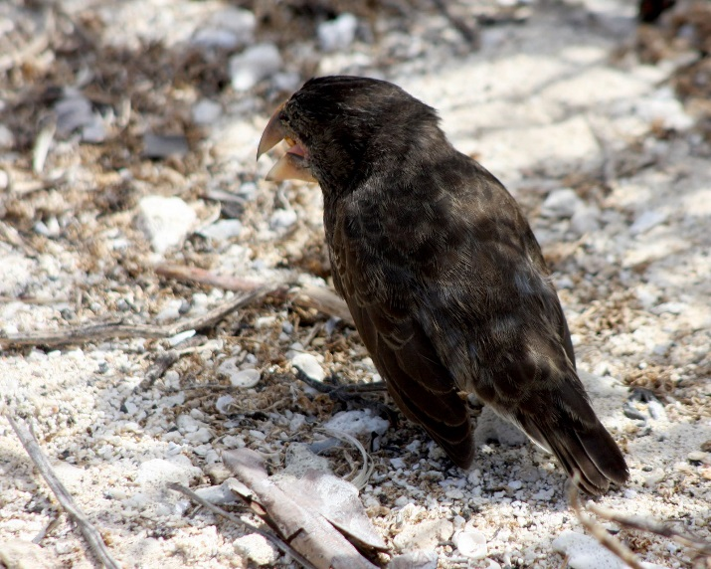
Darwin’s Observations
Galapagos Islands
Similar species existed on different islands with slightly altered traits
EX. Darwin noted 13 species of finch, one from each island, all with a different beak shape perfect for its particular food source
Could these similar species have evolved from a common ancestor?

Slide 13
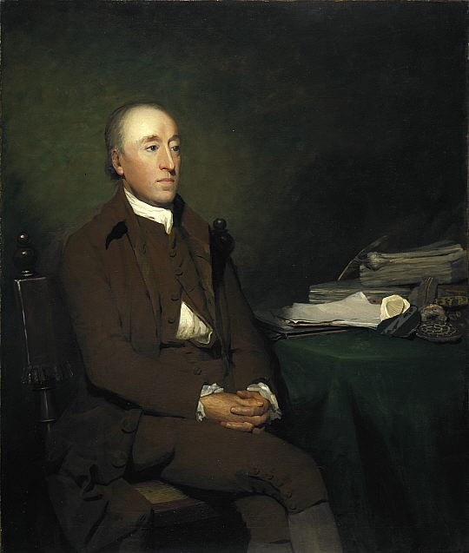
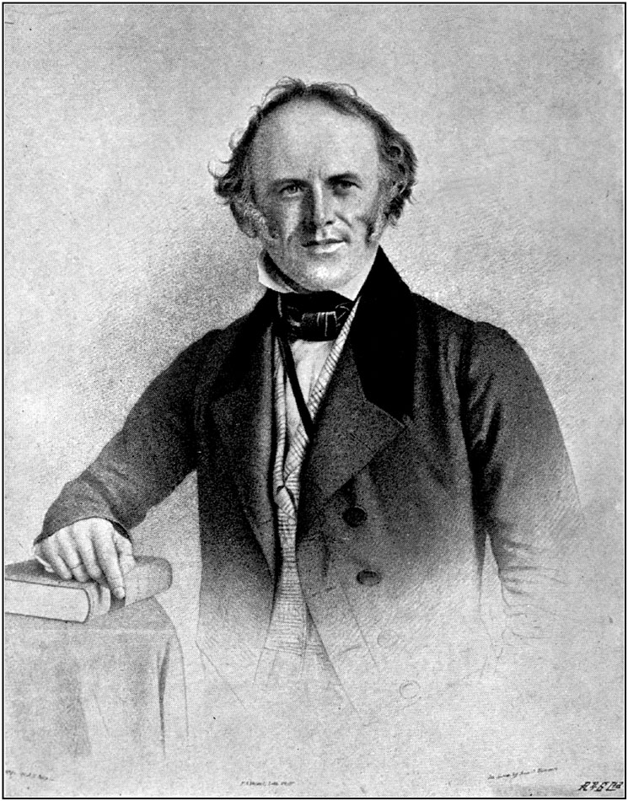
The influence of others on Darwin
James Hutton - Geologist
Geological processes are slow, so the Earth must be more than a few 1000 years old
Charles Lyell – Geologist
Processes occurring now have shaped the Earth’s formation over long periods of time (Gradualism)
Could life change as well?

Slide 14
The influence of others on Darwin
Jean-Baptiste Lamarck – Naturalist
Theory of inheritance of acquired traits
Organisms develop adaptation by “use or disuse” of organs, and pass these traits to their offspring – INCORRECT but influential
Thomas Malthus – Economist
If human populations continue to grow unchecked, they will eventually run out of resources
Only war, famine, disease could control the population

Slide 15
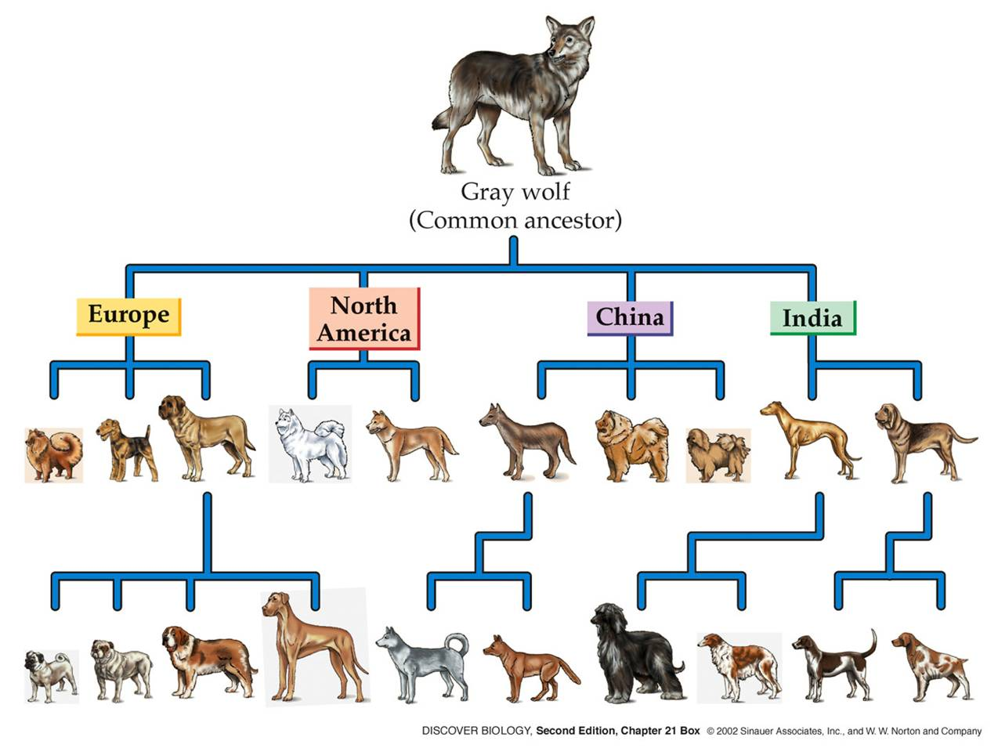
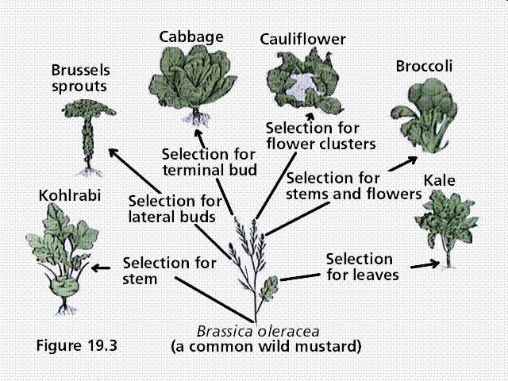
Artificial Selection – The influence of farmers and breeders on Darwin
English farmers and breeders routinely used variation to improve crops and livestock
Through selective breeding, farmers would determine which individuals to use for breeding based on natural variation (biggest pigs, etc.)
Darwin calls this artificial selection
Nature provides the variation and humans select the traits they find useful
Could a similar process exist in nature without human influence?

Slide 16
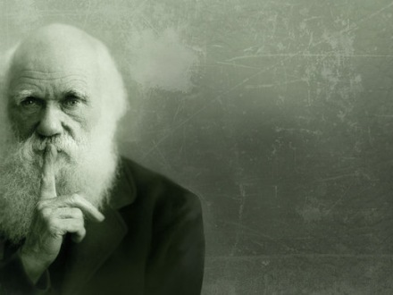

Slide 17
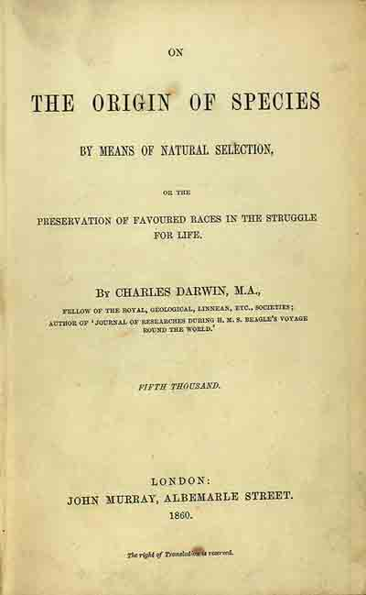
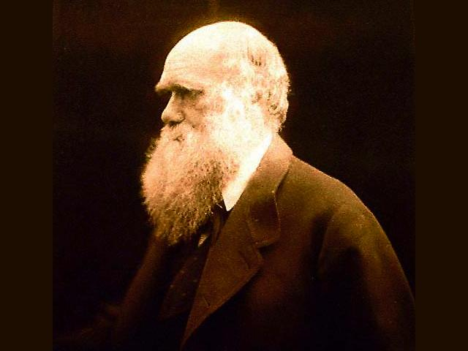
What is natural selection?
In 1859, Charles Darwin published his book On the Origin of Species, where he explained how species evolve by a process called natural selection

Slide 18
Darwin’s Idea
Darwin realized that adaptations increase the fitness of an organism
Fitness is an organism’s ability to survive and reproduce in a specific environment
Darwin realized that organisms with high fitness were more likely to survive and reproduce

Slide 19
What is natural selection?
Natural Selection – process where organisms with the best adaptations for their environment survive, reproduce, and pass their genes to the next generation
Natural selection is a 4-step process:
Overproduction – there are more organisms born than the environment can support
Competition – organisms compete with other members of the population for resources (food, shelter, water, mates)

Slide 20
What is natural selection?
Survival of the Fittest – organisms in a population are not all the same (variation) - organisms with better adaptations are more successful than organisms without these adaptations so they tend to live longer and reproduce more
Passing of Traits – genes that cause adaptations are passed from one generation to the next, changing the gene pool and causing changes in the overall traits of the species (beneficial adaptations appear more frequently)

Slide 21
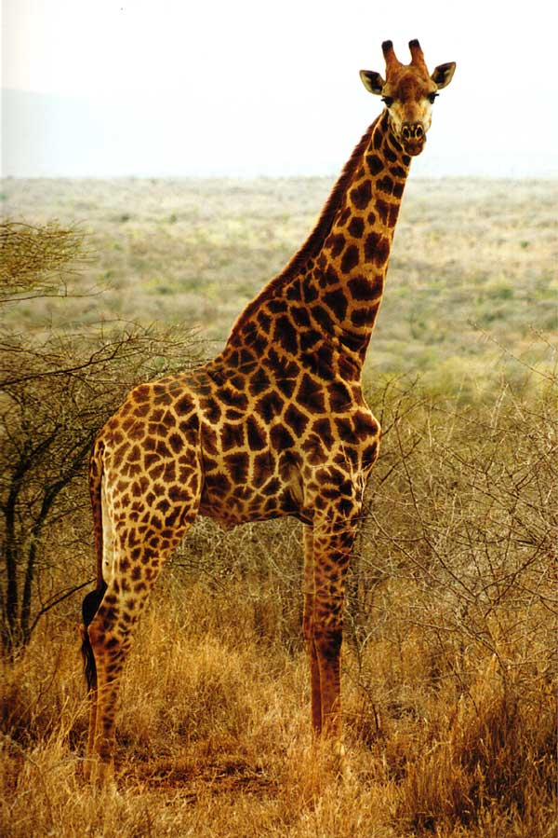
EX. Giraffes
More giraffes are born than the environment can support
Giraffes compete for resources
The giraffes with the longest necks have a survival advantage, so they survive longer and reproduce more

Slide 22
EX. Giraffes
The genes causing the longest necks are passed on more than the other neck genes, changing the giraffe gene pool and causing the average neck length of giraffes to increase from one generation to the next

Slide 23
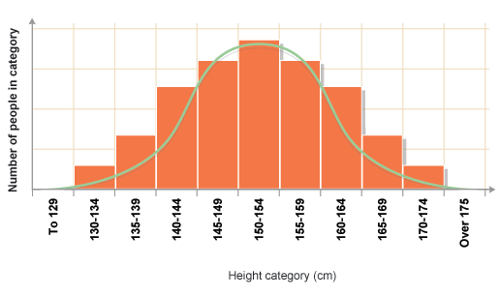
Types of Natural Selection
Variation of species characteristics occurs along a spectrum ranging from one extreme to another
EX. Height in humans, from very short to very tall

Slide 24
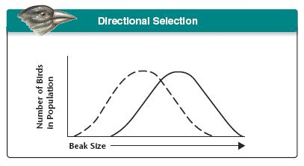
Types of Natural Selection
Directional Selection
Individuals at one end of the variation curve have increased fitness

Slide 25
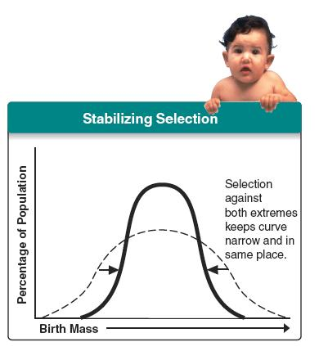
Types of Natural Selection
Stabilizing Selection
Individuals in the middle of the variation curve have increased fitness

Slide 26
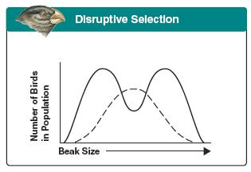
Types of Natural Selection
Disruptive Selection
Individuals at both ends of the variation curve have increased fitness
May lead to the development of two subspecies

Slide 27
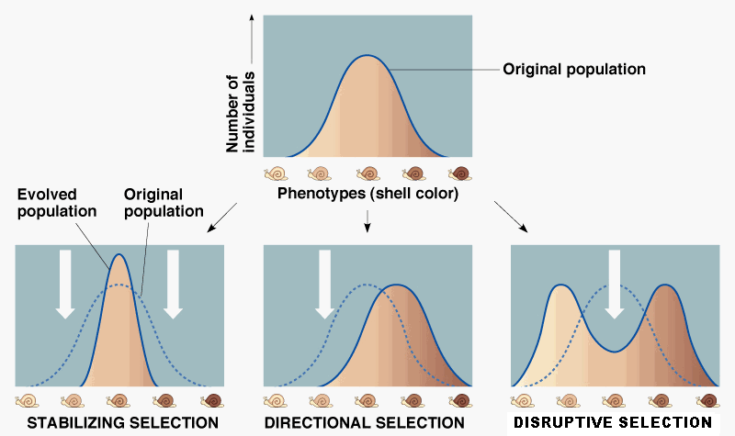
Types of Natural Selection

Slide 28
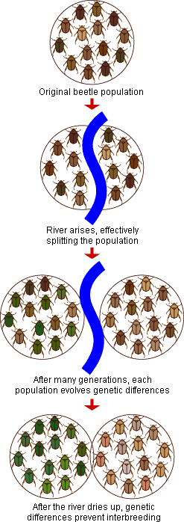
Speciation
Speciation is the formation of new species
Speciation may occur when a population splits into two or more groups that become reproductively isolated and continue to evolve independently of one another

Slide 29
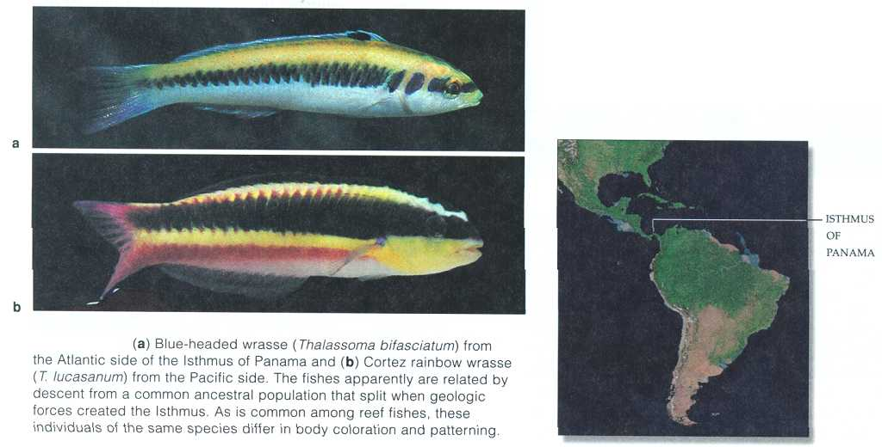
Speciation
Reproductive isolation occurs in three ways:
Behavioral Isolation – differences in behavior prevent mating between two populations
Geographic Isolation – geographic barriers prevent mating between two populations
Temporal Isolation – two populations reproduce at different times, so they don’t mate with one another

Slide 30
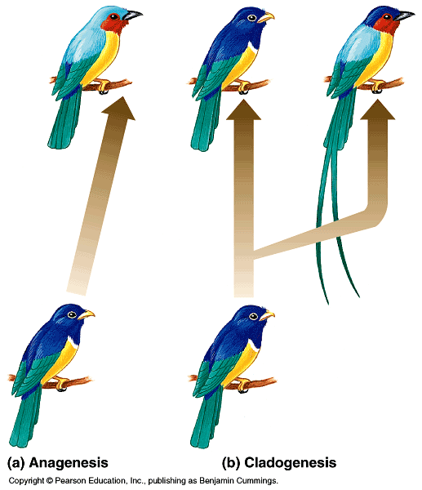
Speciation: Anagenesis vs Cladogenesis

Slide 31
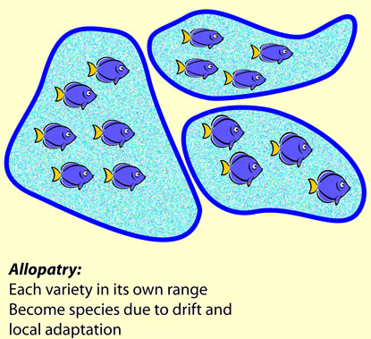
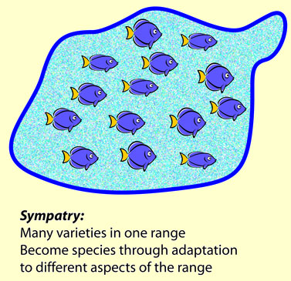
Types of Speciation

Slide 32
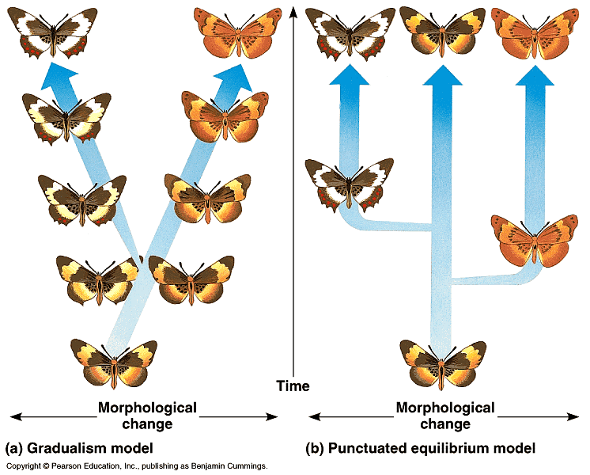
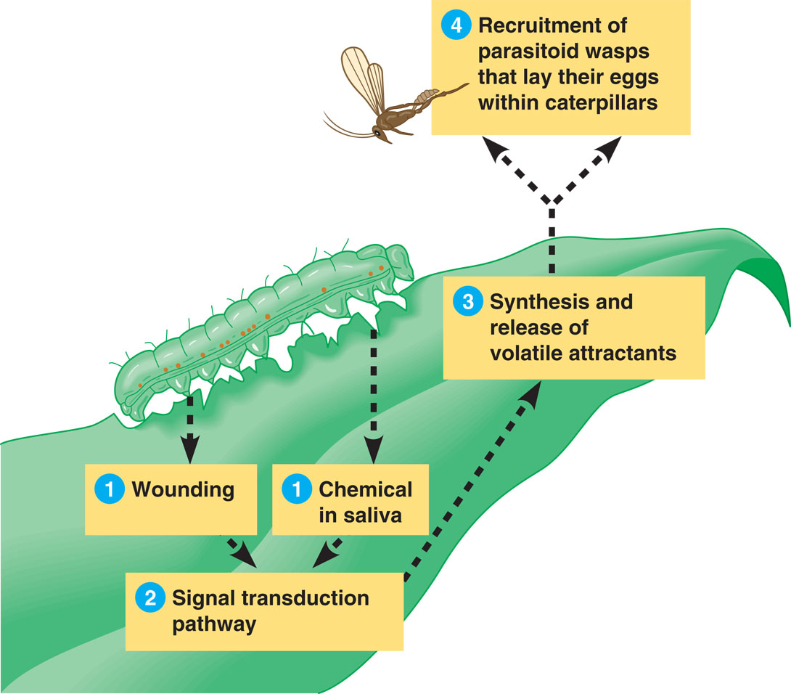
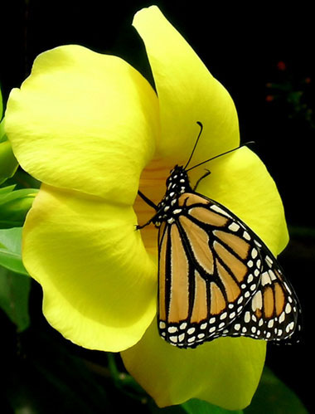
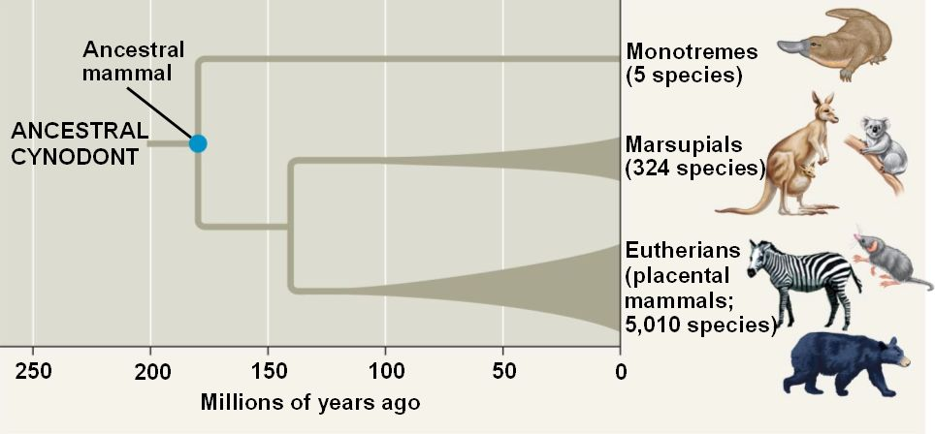
Patterns of Evolution
Adaptive Radiation – one species, or a small group of species, gives rise to many new species
Convergent Evolution – Process by which unrelated organisms come to resemble one another
Happens when different organisms face similar environmental demands
EX. Streamlined bodies and swimming appendages in fish and aquatic mammals (whales, etc.)
Coevolution – When two species evolve in response to changes in one another over time
EX. Flowers and insects, predator/prey relationships
Punctuated Equilibrium – Rapid evolution after long periods of equilibrium

Slide 33
Remember…
Individuals DO NOT EVOLVE
Species populations evolve when traits are passed from one generation to the next in an unequal way, which makes some traits appear more than others in the next generation
Over time, natural selection results in changes in the inherited characteristics of a population, which increases a species’ fitness in its environment
Over many generations, this can lead to large changes in the overall traits of a species population, and even create new species

Slide 34
