Slide 1
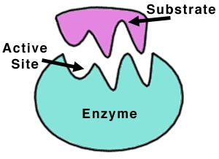
Enzyme Structure
24/12/2014
What is an enzyme & how do they speed up reactions?

Slide 2
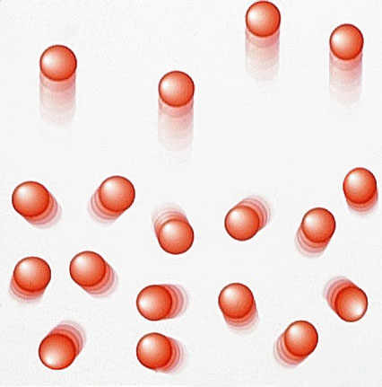
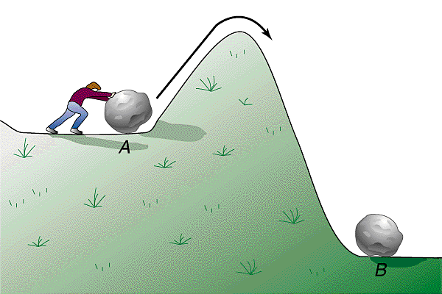
Activation energy
The minimum energy needed by particles for a reaction to happen
How can we make the reaction more likely to happen?
Reactants
Products

Slide 3
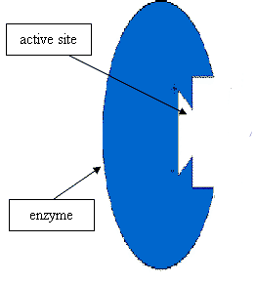
What is an enzyme??
Biological catalyst
Speeds up the chemical reactions within the cell
A protein
Have a special region called the ‘active site’
Lower the activation energy needed for a reaction to occur

Slide 4
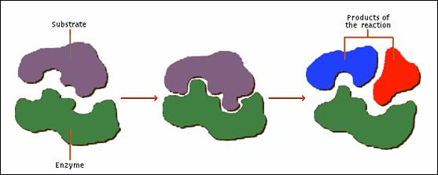
How enzymes work – lock and key method
Active Site
Enzyme has the same shaped active site as the substrate
Reaction is catalysed
New products formed

Slide 5
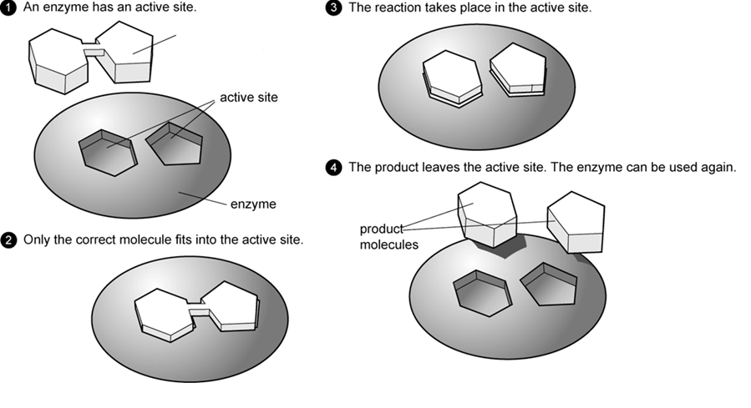
How do they work?
Enzyme-substrate complex
Specific!

Slide 6
Enzymes like certain things!
They like the right temperature and the right pH!
If it is too hot, cold, acidic and alkali then reactions will be affected.

Slide 7
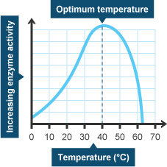
Temperature
When temperate is too low, there is a low collision rate between the enzyme and substrate. Less collisions = less reactions!
Vice versa for a higher temperature
Optimum temperature is when the reaction goes at its fastest rate! This is just before it is too hot to affect the enzymes. The optimum temperature for human enzymes is 37ºC
If the temperature is too hot, the bonds holding the enzyme together break! This means that the active site changes shape and can no longer fit with the substrate. The enzyme cant function and the reaction stops.
This means that the enzyme has been denatured. It is irreversible!

Slide 8
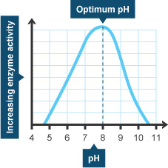
pH
If the pH is too high or too low, the bonds holding the enzyme are changed.
This means the active site of the enzyme changes shape and the substrate will no longer fit.
This means the enzyme is denatured and the reaction stops.
All enzymes have an optimum pH. Normally it is pH7/neutral.
There are some enzymes which like acidic conditions, e.g. stomach enzymes which work at pH2.

Slide 9
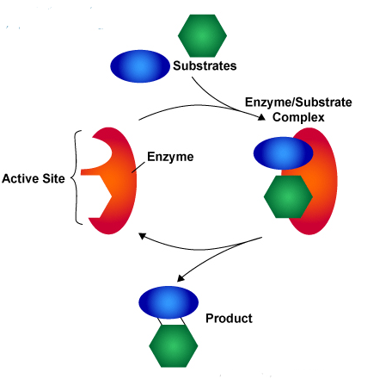
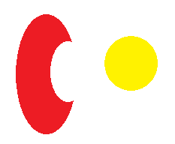



Builder & breaker Enzymes
Builder
Breaker
Substrate
Enzyme
Enzyme-Substrate complex
Products

Slide 10
Enzyme Cartoon
To show that you understand the lock and key model of enzyme activity you must:
Write the statements in the correct space on your cartoon strip
Draw diagrams to illustrate what is happening at each stage in the Breaker cartoon
The 2 products are released from the enzyme, allowing it to be used over again
The substrate binds to the enzyme active site forming the enzyme substrate complex
The enzyme causes the reaction to happen
Enzymes have an active site which is complimentary to the shape of the substrate molecule

