Slide 1
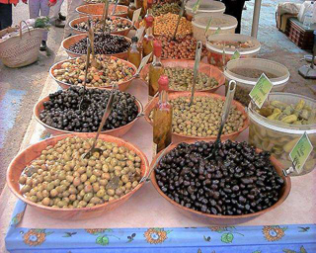
Lipids: Fats & Oils

Slide 2
Key term- Lipid
The name lipid is used to describe a range of substances. Some of the most important of these are triglycerides, usually known as fats and oils

Slide 3
Types of Lipids
Lipids with fatty acids
Waxes
Fats and oils (trigycerides)
Phospholipids
Sphingolipids
Lipids without fatty acids
Steroids

Slide 4
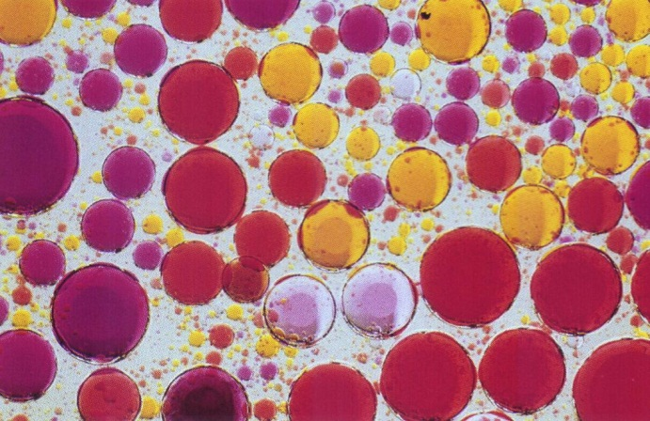
Lipids
Made up of C, H and O
Can exist as fats, oils and waxes
They are insoluble in water
They are a good source of energy (38kJ/g)
They are poor conductors of heat
Most fats & oils are triglycerides

Slide 5
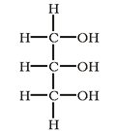

A triglyceride contains four subunits : glycerol and three fatty acids
Glycerol- an alcohol
Fatty Acids

Slide 6
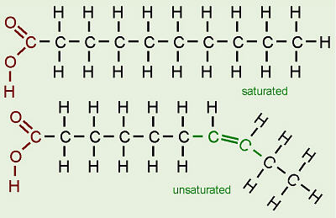
2 types of fatty acid
Why are unsaturated fatty acids usually liquid at room temperature, whereas saturated fatty acids are usually solid?

Slide 7
Triglycerides
3 fatty acid molecules joined to a glycerol
Each fatty acid consists of an acid COOH group joined to a long hydrocarbon chain consisting of carbon and hydrogen
The length of the hydrocarbon chain varies but in many of the fatty acids in triglycerides there are between 14 and 16 carbon atoms

Slide 8
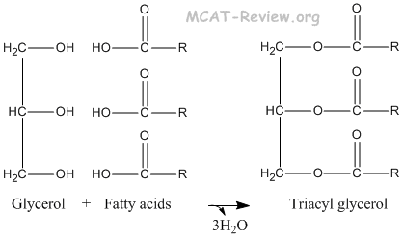
Ester Bonds
Triglyceride

Slide 9
Phospholipids
These are very similar to triglycerides except that one of the fatty acids is replaced with a phosphate group

Slide 10
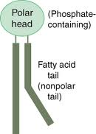
Phosphate group on the head of the molecule means the charge on the molecule is unevenly distributed. It is polar and hydrophilic
The hydrocarbon tails do not have an uneven charge distribution. They are non-polar and hydrophobic.

Slide 11
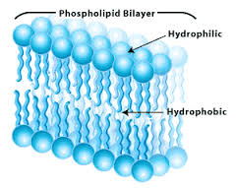
Bilayer
If placed in water phospholipids will arrange themselves in a double layer with the hydrophilic heads pointing outwards and the hydrophobic tails pointing inwards.
This double layer forms the phospholipid bilayer and is the basis of cell membranes

Slide 12
Functions of lipids
Protection of vital organs
To prevent evaporation in plants & animals
To insulate the body
They form the myelin sheath around some neurones
As a water source (respiration of lipids)
As a component of cell membranes

